Slide 1
Solar Panel Roadways
Kun Yang

Slide 2
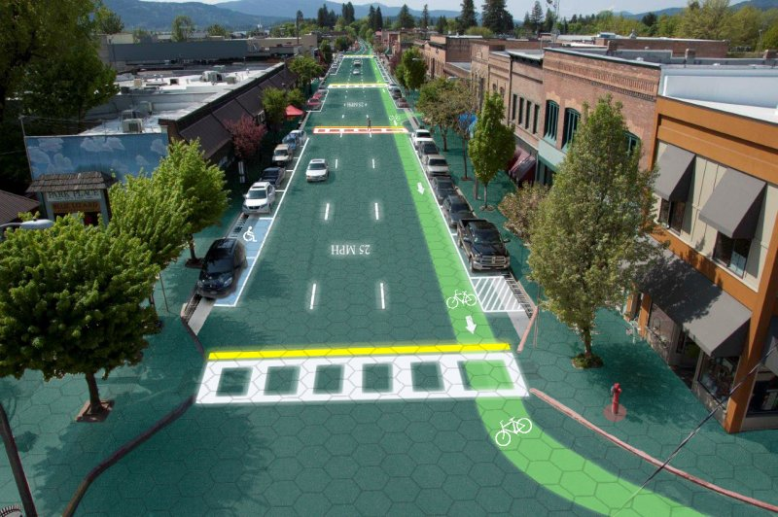
What is Solar Panel Roadways?
Brusaw Couple,
Solar Energy=electricity
Asphalt roadways cover with solar panels!

Slide 3

So why do we need to use solar energy?
fossil fuel
coal burning
Nuclear Fusion
Solar Energy is a clean energy.

Slide 4
Pros and Cons of Solar Energy
Pros:
Renewable, abundant.
Clean Energy Source
Reduce electricity cost
Cons:
Works only during daytime
Require Batteries to store Electricity
Expansive to acquire solar panels at first.

Slide 5
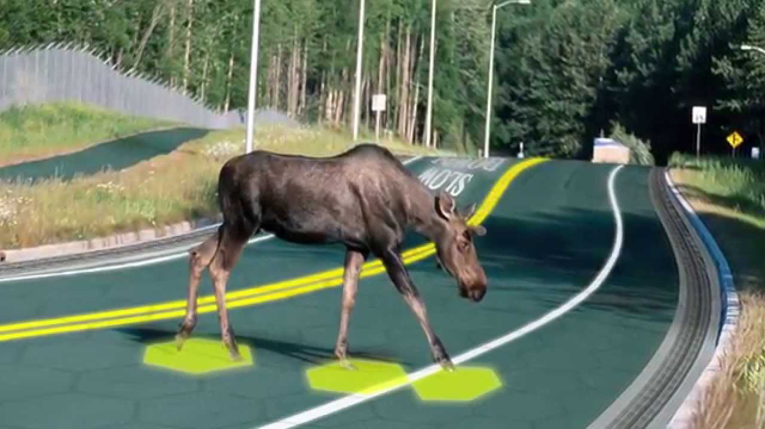
Solar Panels Roadways is a plus
generate electricity
provide jobs
Safety and Entertainments

Slide 6
Conclusion
It is concluded that the Solar Panel Roadways is the most efficient way to acquire solar energy.

Slide 7
Thank You

Slide 8
Works Cited
Doreen “Spending too much to gas up?” Tribune content agency LLC April 12th,2012
Badie Rick “Solar Energy Pros, Cons” The Atlanta Journal March 25th, 2015
Energy Source”Disadvantage of Nuclear Energy-Conserve Energy Future” January 20th, 2013
Union of Concerned Scientists “Coal power: air pollution” July 7th, 2015

